Slide 1
AZ-900 Part Quatre

Slide 2
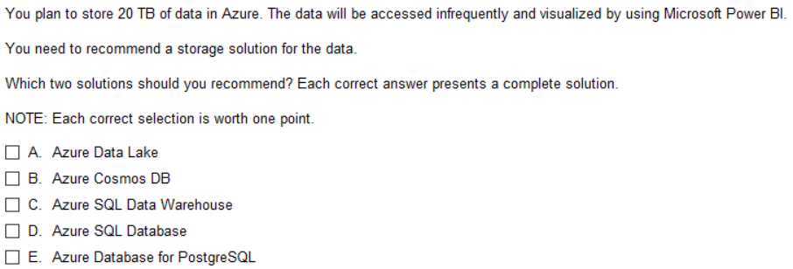
Q1
Note: you can use PowerBI with any DB
But only DataLakes and Warehouses are
Accessed infrequently

Slide 3
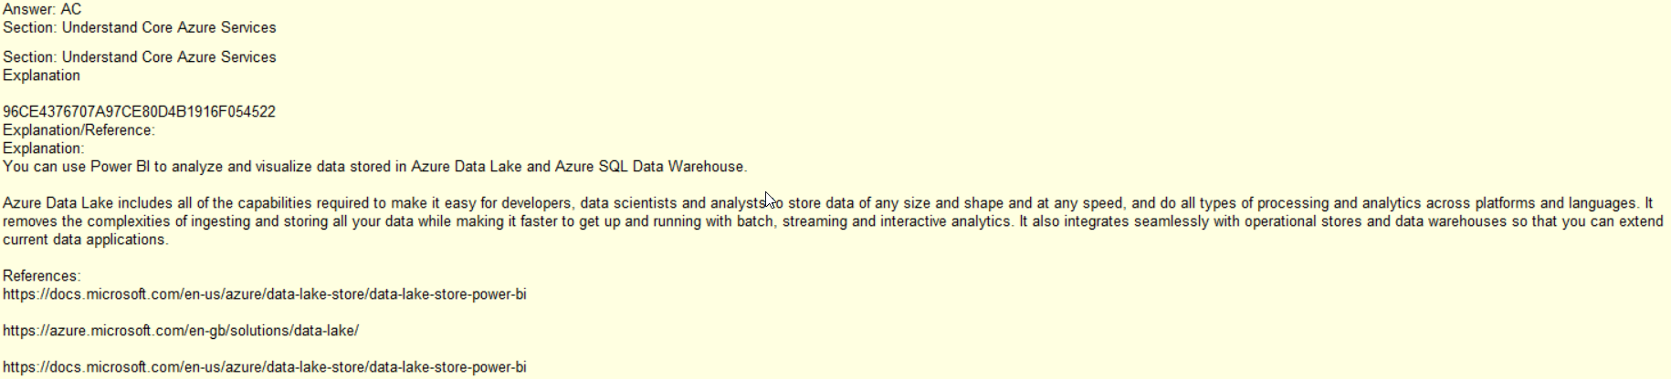
Accessed for query less frequently
Reason for products like Snowflake
Which can load/cache index points to make
Retrieval more workable

Slide 4
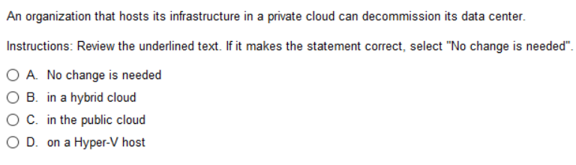
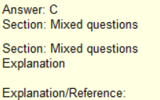
Q2
No, you can have a private cloud OR
A public cloud in a Data Center
Remember: A company’s DC could be a closet
with a Server computer or a room a or multiple
racks. No guarantee that companies DC will
Be anything like a DC that hosts public

Slide 5
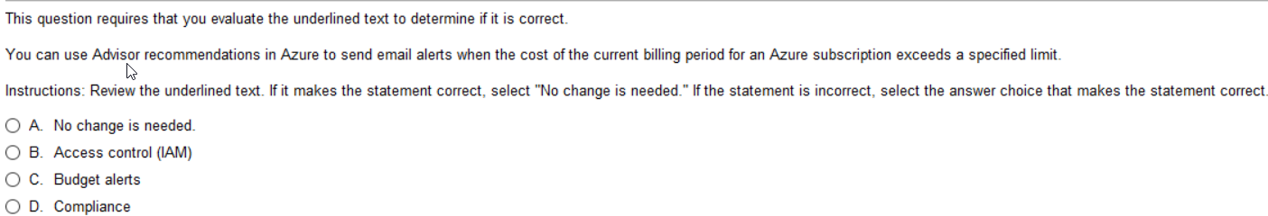
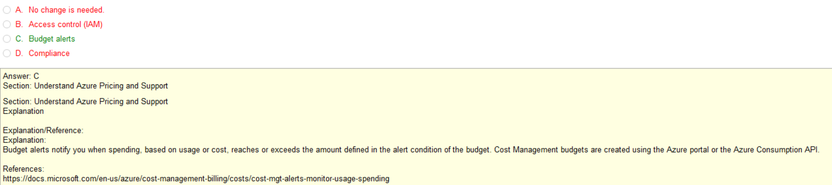
Q3
Access and Authentication
Azure Budget allows you send alerts
Azure Compliance is not actually a product. Its more of a concept.
For example: ISO 9001 isn’t a service, it’s a level of compliance.
Compliance is part of Microsoft Security.
Security Center continuously assesses your hybrid cloud environment to analyze
the risk factors according to the controls and best practices in the standards applied
to your subscriptions.
Advisor Alerts typically deal with addresses fail points
Like lack of redundancy, better pricing, some security

Slide 6
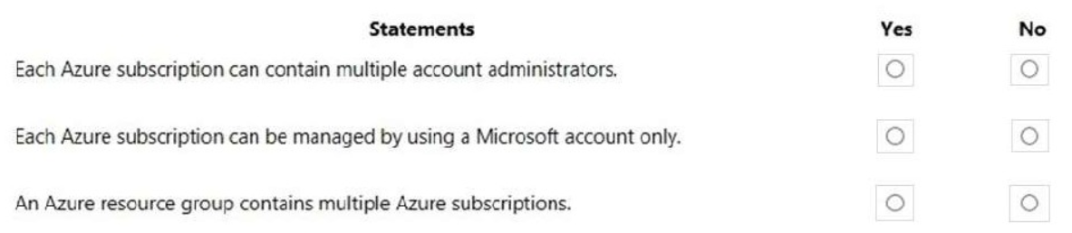
Q4
NOTE: Microsoft account might be an O365 or just email account or Service Account
Azure Subscription can be managed by Microsoft account, but must be administrative Microsoft Acct
You can have your O365 be your gmail address.

Slide 7
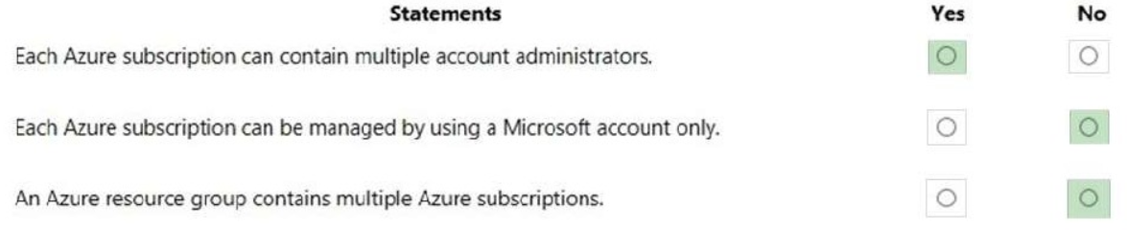
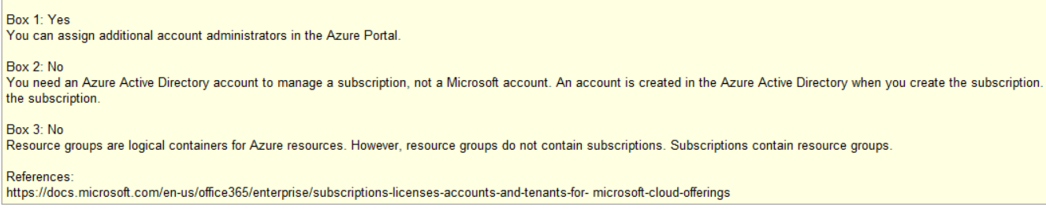
Q4
the subscription

Slide 8
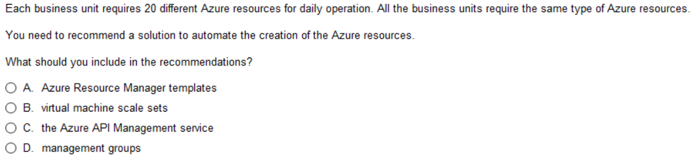
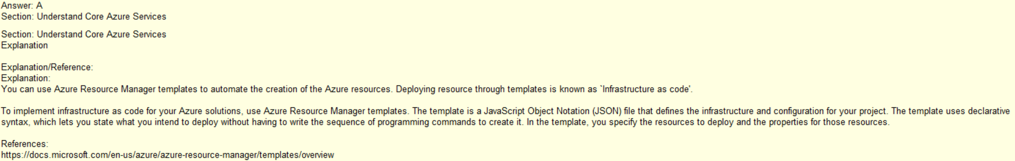
Q5
Used to automate the creation of the typical Azure resources, not just machines
Used to scale out multiple of the same type machines
API Management provides the core competencies to ensure a successful API program
through developer engagement, business insights, analytics, security, and protection.
An Azure Management group is logical containers that allow Azure Administrators to manage access,
policy, and compliance across multiple Azure Subscriptions en masse.

Slide 9
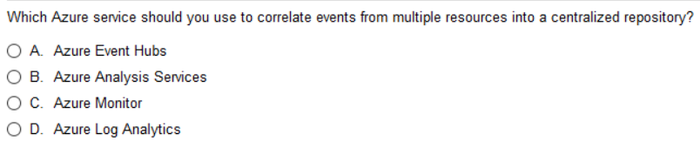
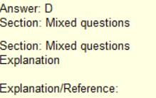
Q6
Event Hubs is a fully managed, real-time data ingestion service that’s simple, trusted, and scalable.
Azure Monitoring looks at different logs and traces and fire alerts and send notifications
or call automated solutions.
Azure Log Analytics is a tool in the Azure portal to edit and run log queries from data collected
by Azure Monitor Logs and interactively analyze their results. Analytics from Central Repo
Azure Analysis Services is a fully managed platform as a service (PaaS) that use advanced mashup and modeling features to combine data from multiple data sources, define metrics, and secure your data in a single, trusted tabular semantic data model. The data model provides an easier and faster way for users to perform ad hoc data analysis using tools like Power BI and Excel. Not Centralized, no guarantee
Note: tough question. And subjective. I don’t like this question. You may just need to commit to memory.
Azure Event Hubs pushes data into one or more repos, does not correlate.
Azure Analysis Services combines data into a model for ad hoc analysis using tools like Power BI, but doesn’t’
correlate to a Centralized Repo (Could be this)
Azure Monitor – monitors traffic
Azure Log Analytics – run log queries and interactively analyze results thus correlating into Central Repo,
meaning Log file not typically split between two Repos, no easy way to do it
(this is better of two answers Azure Analysis Services and Log Analytics)

Slide 10
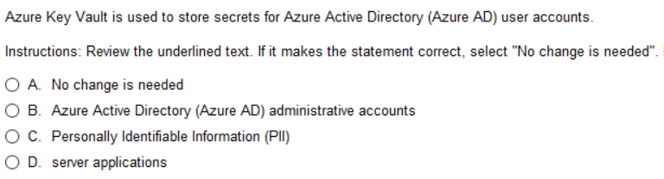
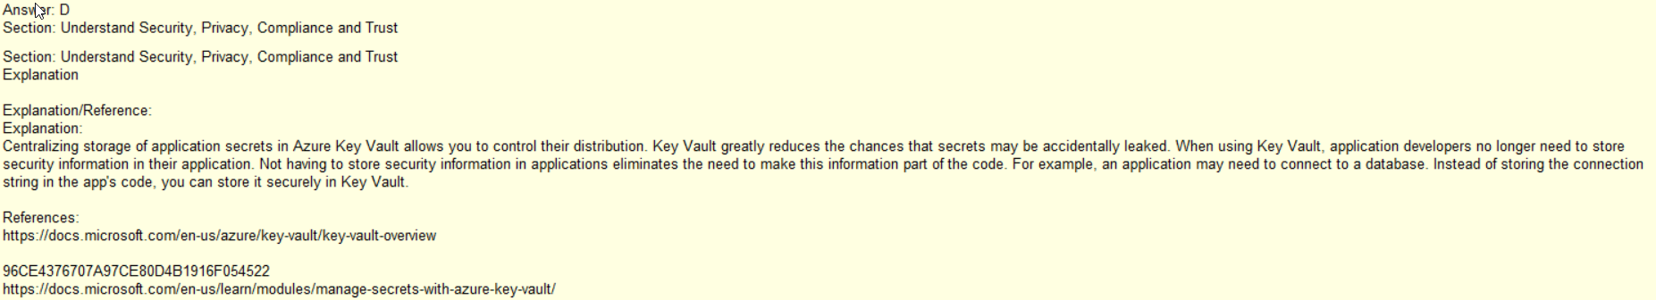
Q7
Often services, like DBs need a non-user
Accounts that are used to start the server
at StartUp and to give different permission
Sets.
Key Vault rotates passwords for you.

Slide 11
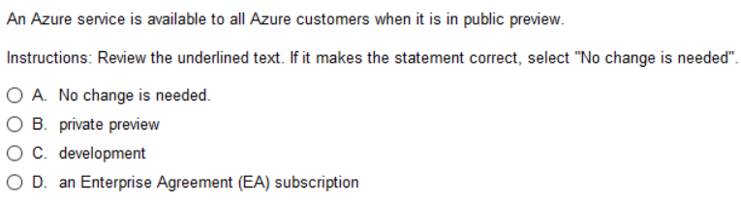
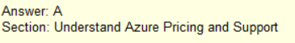
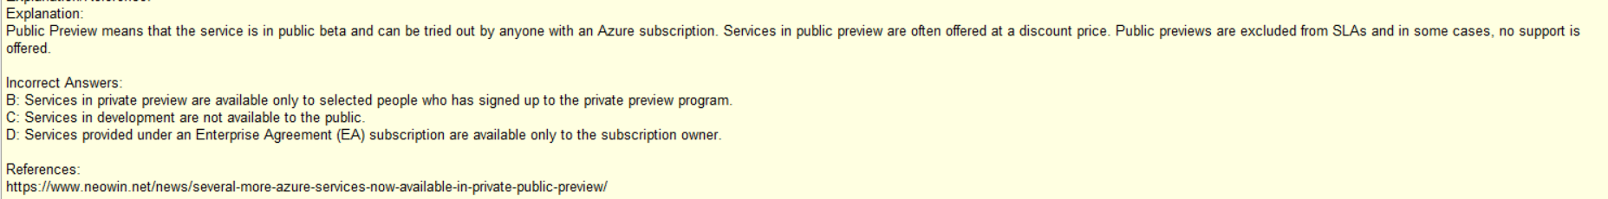
Q8

Slide 12
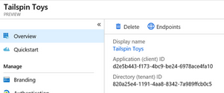
Preview
There are two types of previews, private and public.
Private preview is only available to certain Azure customers for evaluation purposes.
The public preview is available to all Azure customers.
Azure may include preview, beta, or other pre-release features, services, software, or regions offered by Microsoft to obtain customer feedback ("Previews"). Previews are made available to you on the condition that you agree to these terms of use, which supplement your agreement governing use of Azure.
Announce EOL
S
NO SLA, NO SUPPORT |
NO SLA, NO GUARANTEED SUPPORT |
SLA, SUPPORT
EOL Support
Public
Preview
Public
12 months
Private
Preview

Slide 13
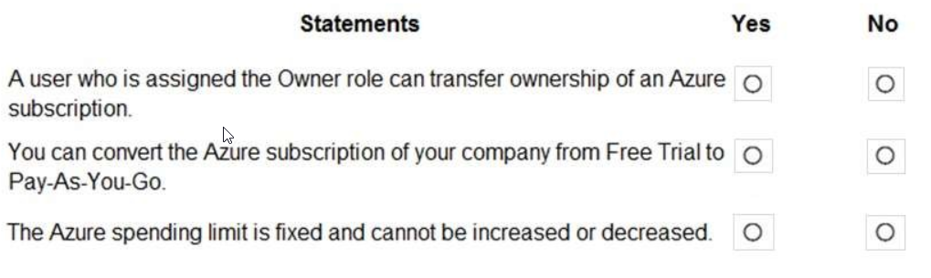
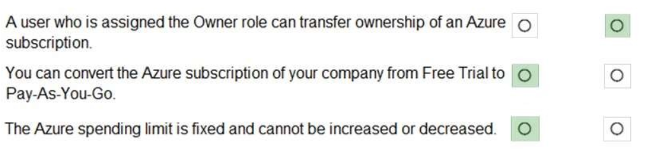
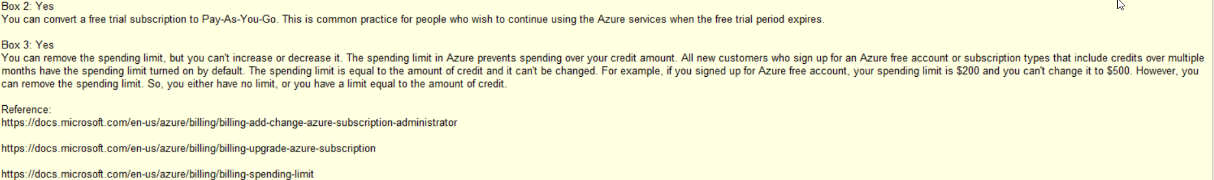
Q9
Owner may not be administrator
Free Trial is basically pay as you go with $200 credit
Never a spending limit if you have a CC on file with appropriate credit

Slide 14
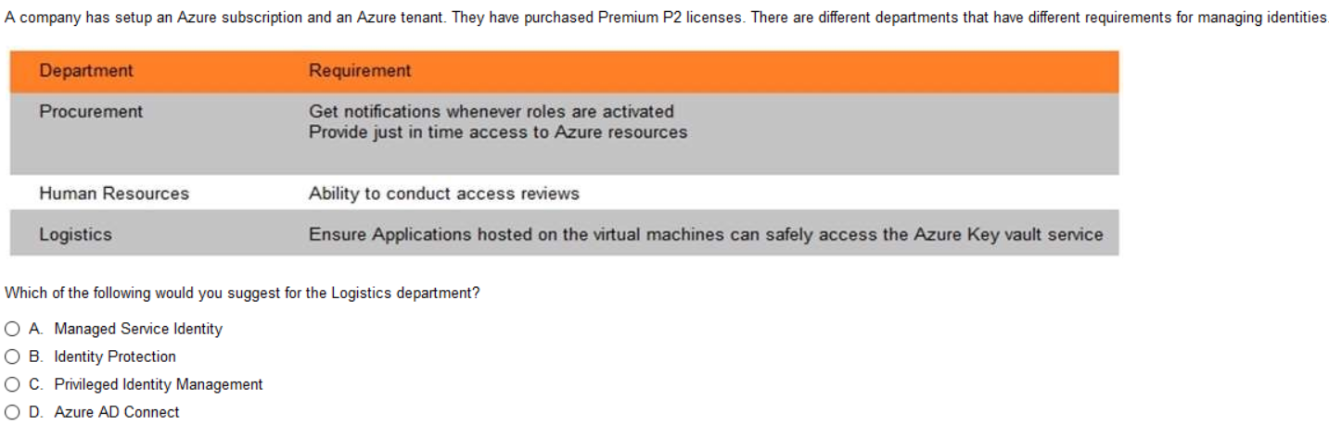
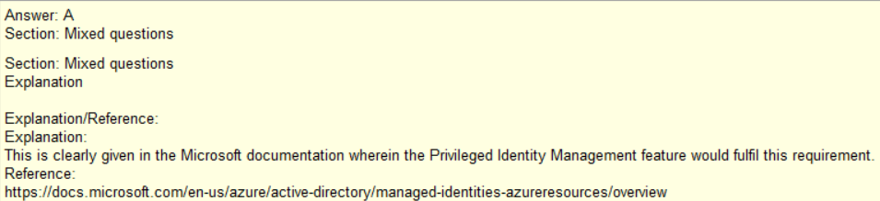
Q9
Managed Service Identity:
Manage credentials across multiple subscriptions. Credentials that are not even accessible to you.
You can use managed identities to authenticate to any Azure service that supports
Azure AD authentication including Azure Key Vault.
Identity Protection is a tool that allows organizations to accomplish three key tasks:
Automate the detection and remediation of identity-based risks.
Investigate risks using data in the portal.
Export risk detection data to third-party utilities for further analysis.
Privileged Identity Management (PIM) is a service in Azure Active Directory (Azure AD) that enables you
to manage, control, and monitor access to important resources in your organization.
These resources include resources in Azure AD, Azure, and other Microsoft Online Services
such as Microsoft 365 or Microsoft Intune.
Azure AD Connect is a tool for connecting on premises identity infrastructure to Microsoft Azure AD.

Slide 15
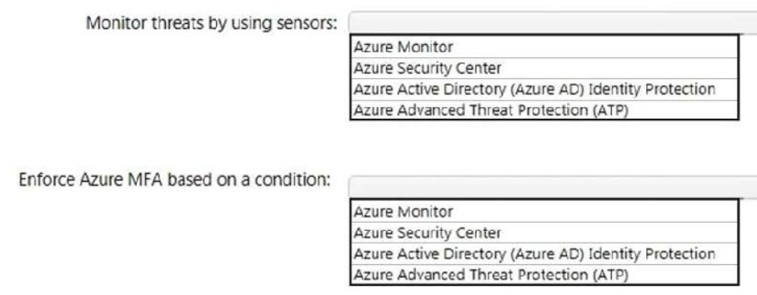
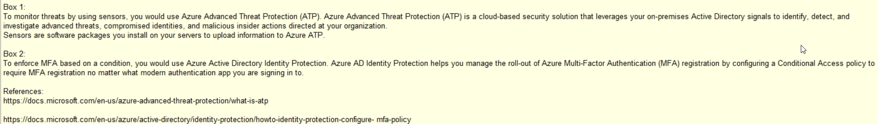
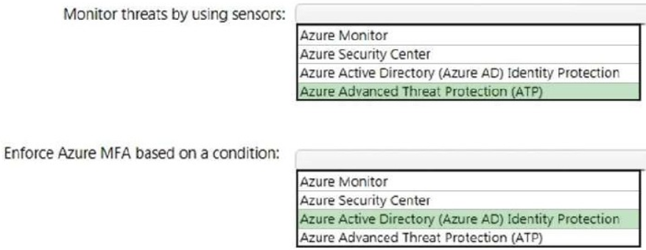
Q10
Monitors, but not threats, perf, status
Generic Answer includes Ident Protection and ATP
Part of Azure Security Center
Part of Azure Security Center
Part of Azure Security Center, ie force login with MFA
Part of Azure Security Center

Slide 16
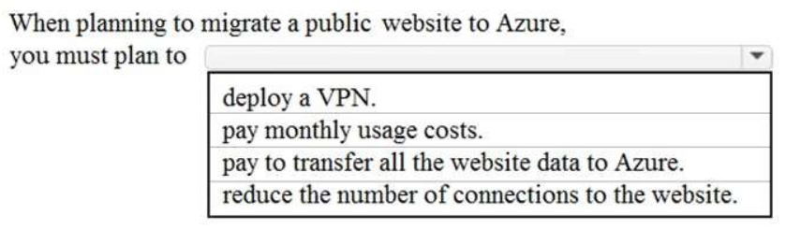
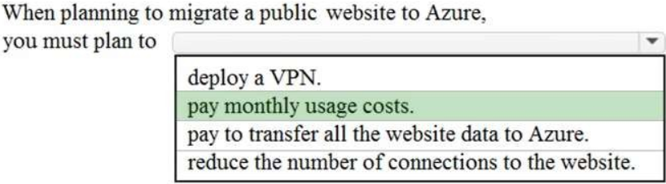
Q11
Why would we need VPN for a public website
Only pay to get pull it down
Why would we need to reduce connections
Tip: Most important thing to Microsoft
Their perspective

Slide 17
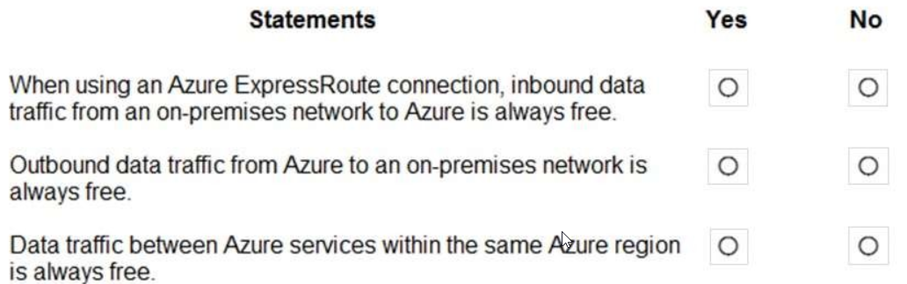
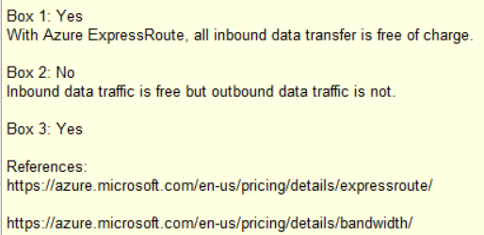
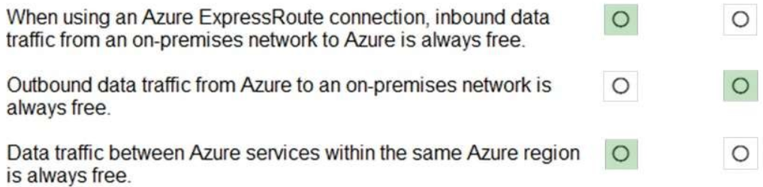
Q12
Never Free
But not for different Regions

Slide 18
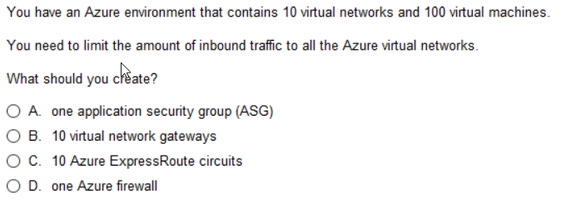
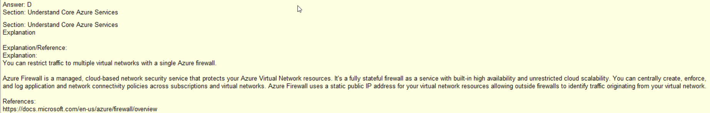
Q13
Limits specific application to be passed to/from a specific component
Virtual network gateways doesn’t necessary limit anything, only components
on individual VNETs are allowed to certain other elements on that VNET
Just a dedicated private link to the cloud, doesn’t limit public traffic
Limits all traffic

Slide 19
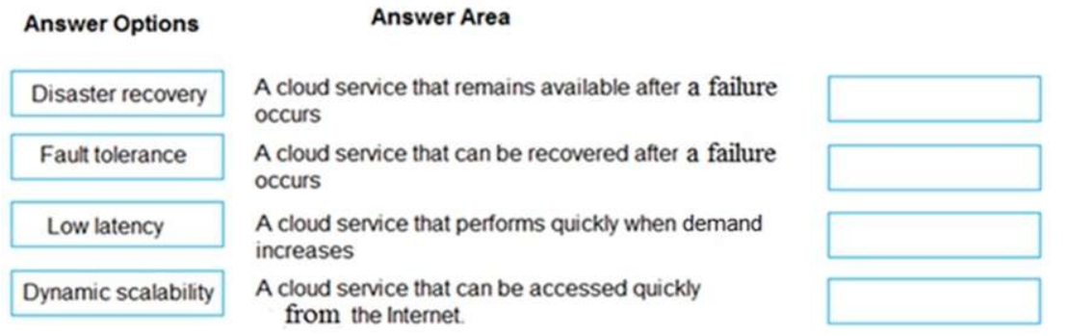
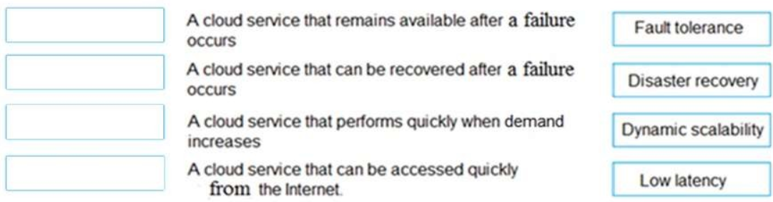
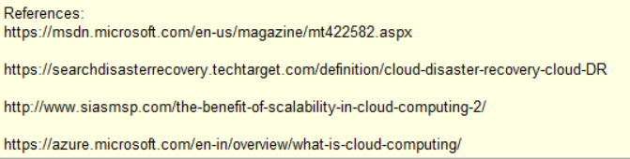
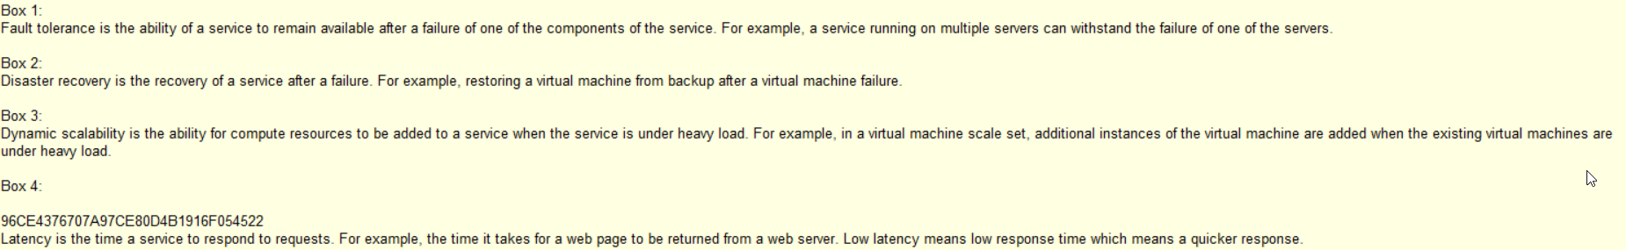
Q14

Slide 20
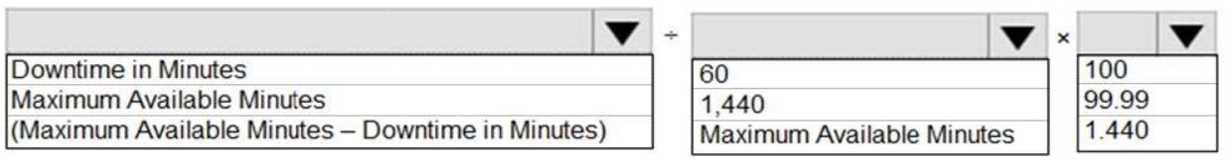
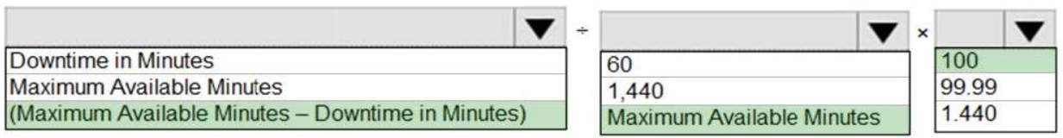
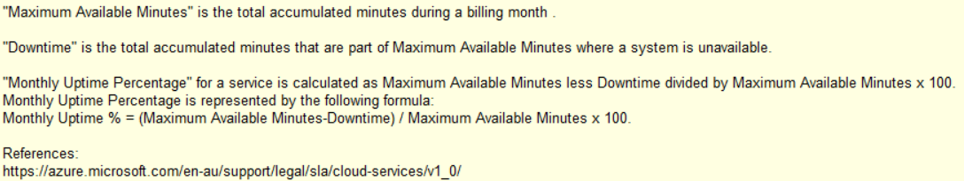
Q15

Slide 21
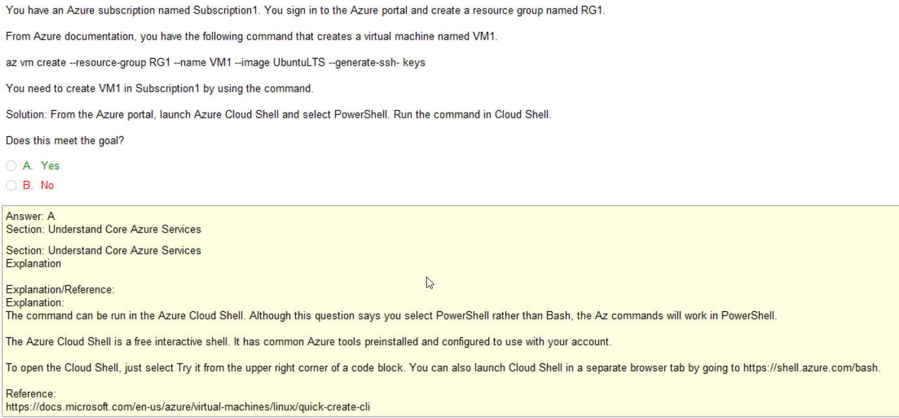
Q16
Note: this is an
Important concept to MSFT
Look: what are they asking
PS or CloudShell, both are CLI

Slide 22
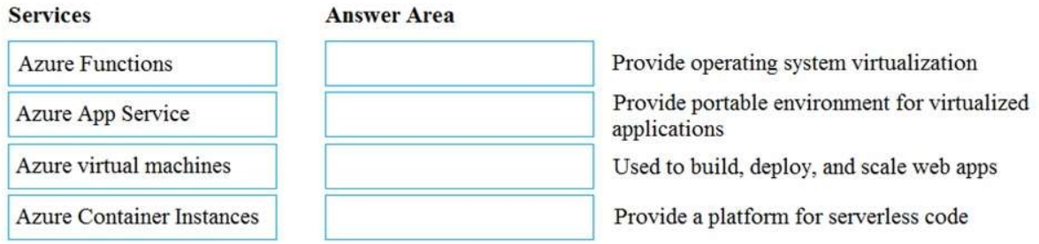
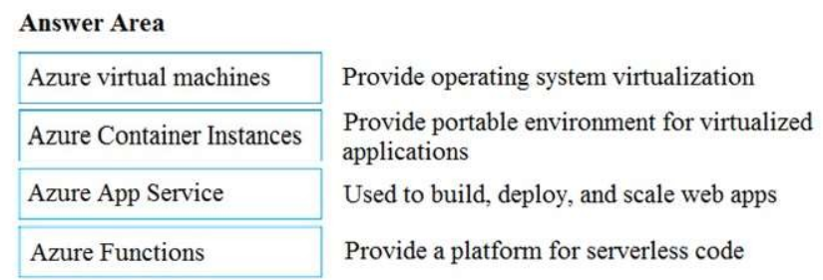
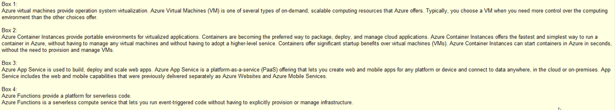
Q17

Slide 23
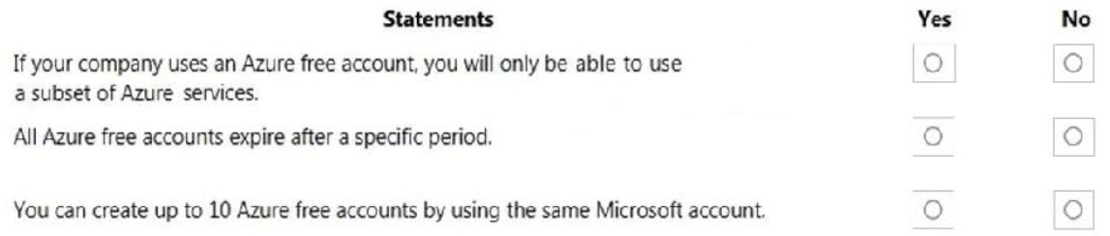
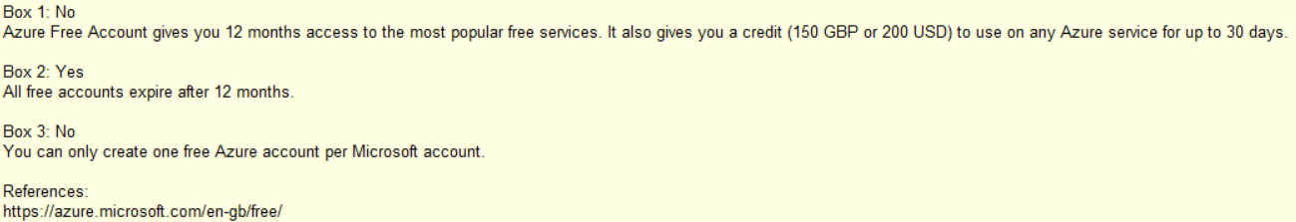
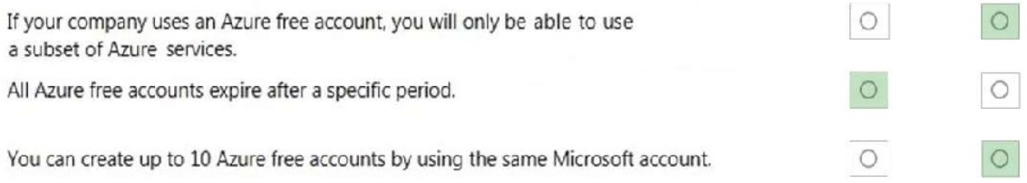
Q18
Azure Free is Pay-As-You-Go with $200 credit w/ expire date
Yes, if not converted
No, 1 account only per account

Slide 24
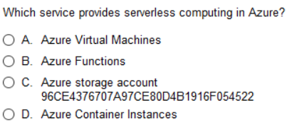
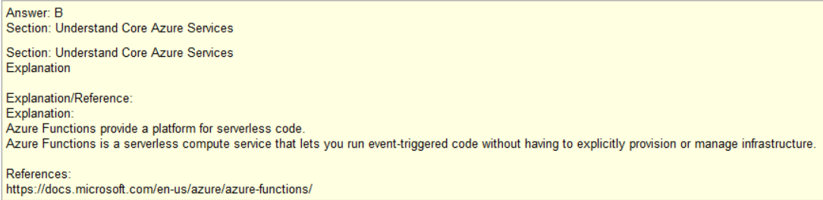
Q19

Slide 25



Q20
PaaS/IaaS bc you are controlling more than config
PaaS/IaaS bc you are controlling more than config
IaaS/PaaS bc you are installing/controlling more than SW
SaaS bc all you are doing is configuring what SaaS give you

Slide 26
APPENDIX – KEY AREAS

Slide 27


Slide 28

Significant Influence
Over Environment
Limited Influence
Over Environment
(Scaling, Location)
Zero Influence
Over Environment
Azure
You
DBMS
Note: Server vs Serverless
-totally stateless
-deployed on demand
-typically small footprint
Virtual Machine
Hard Drive/Space
DBMS (you install
And configure)
Azure Cosmos DB, App Service, CDN
Email
Office (Web)
www.Amazon.com

Slide 29


ExpressRoute
Dedicated Link from your facility to Microsoft Cloud
Often implemented as MPLS circuit
MPLS
EXPRESSROUTE
Japan
Hawaii
Hamburg
London
MPLS
Dubai
Paris
NYC
Boston
Geneva

Slide 30




Azure Regions
CDN
Edge
Edge

Slide 31

Classification Types of Azure Storage

Slide 32


Slide 33


Slide 34



Slide 35

Locally redundant storage
Zone-redundant storage
Zone-redundant storage
Read-access geo-redundant storage

Slide 36


Slide 37

https://azure.microsoft.com/en-us/support/plans/
Tip: Commit to memory the variances

Slide 38
Preview
There are two types of previews, private and public.
Private preview is only available to certain Azure customers for evaluation purposes.
The public preview is available to all Azure customers.
Azure may include preview, beta, or other pre-release features, services, software, or regions offered by Microsoft to obtain customer feedback ("Previews"). Previews are made available to you on the condition that you agree to these terms of use, which supplement your agreement governing use of Azure.
Announce EOL
S
NO SLA, NO SUPPORT |
NO SLA, NO GUARANTEED SUPPORT |
SLA, SUPPORT
EOL Support
Public
Preview
Public
12 months
Private
Preview

Slide 39

Q11
Tip: CosmosDB can be what you want it to be:
CosmosDB is really three different DBs in one
NoSQL – taking strings like JSON
SQL – handling relational DB
Read the cosmos-db intro
AWS has about 10 different DB.
Microsoft is introducing only CosmosDB.

